Slide 1
Leveraging Domain Knowledge for Class-Specific Keyword Extraction
Bachelor’s Thesis Final Presentation
Weixin Yan, 2 Oct 2023

Slide 2
Outline
Introduction
  Motivation and Goals (Recap)
  Research Questions
Research Approach
  Dataset
  Methodology
Findings
  Extraction Results
  Generation Results
Discussions
  Contributions
  Challenges and Future Work
Conclusion

Slide 3

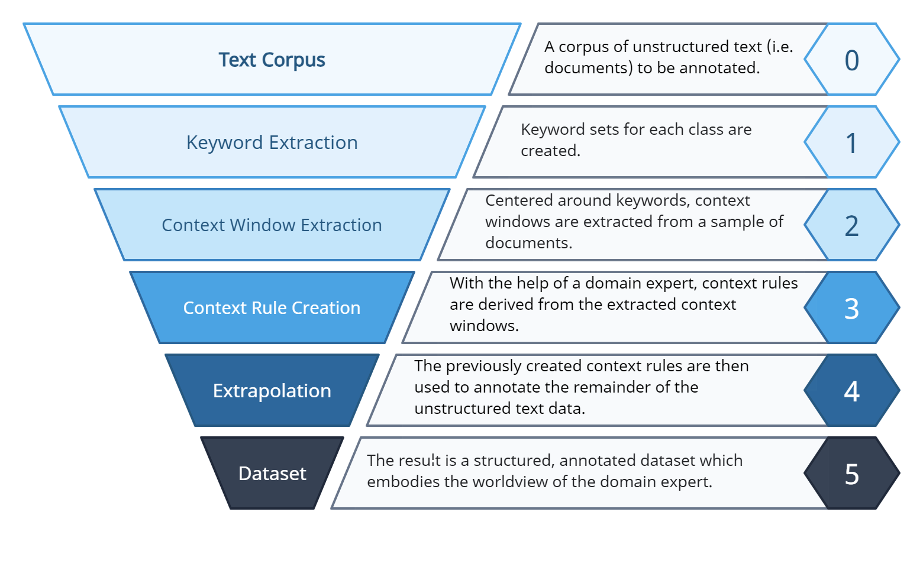


Motivation and Goals (Recap)
  Current data landscape: predominance of unstructured text
  AI applications typically require structured input with clear labels
  → Data annotation needed
  traditional approach: manual annotation by domain experts
  Precise, with domain-specific knowledge
  Costly, inefficient, not scalable
  Step 1: Keyword extraction
    Outcome: (reasonably) complete set of keywords per class
    → basis for the rest of the project
  A hybrid approach that combines Natural Language Processing techniques with domain expertise
https://wwwmatthes.in.tum.de/pages/nqpi6qljq0x9/CreateData4AI-CD4AI

Slide 4
Research Questions
1
What approaches currently exist that can be utilized to extract keywords and keyphrases from large unstructured text corpora?
How can short textual class descriptions and class-specific seed keywords from the WZ2008 classification, validated by domain experts, be leveraged to adapt the identified keyword extraction approaches for class-specific keyword extraction?
2
3
Without the use of external knowledge bases, how can the extracted class-specific keywords be used as a basis for the generation of further class-specific keywords?
4
In what way can the modified approach be evaluated by domain experts to validate the representativeness of the resulting keyword sets?

Slide 5
Outline
Introduction
  Motivation and Goals (Recap)
  Research Questions
Research Approach
  Dataset
  Methodology
Findings
  Extraction Results
  Generation Results
Discussions
  Contributions
  Challenges and Future Work
Conclusion

Slide 6


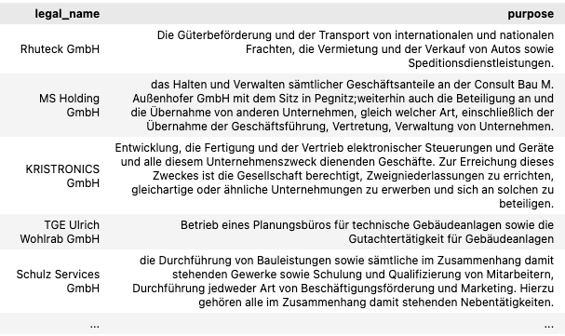
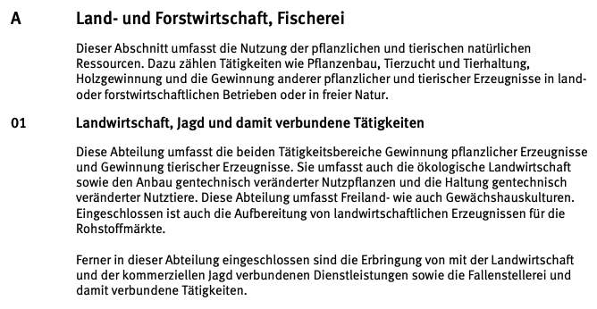
Dataset (Recap)
Business Registry of Business Purposes
(Handelsregister)
Classification of Business Sectors
(Klassifikation der Wirtschaftszweige 2008)
keyword extraction with help of WZ2008
WZ2008
Dataset to extract keywords from
(~3 million entries)
Definitions, explanation and seed keywords of the 21 classes

Slide 7
Workflow Overview
EXTRACTION
GENERATION
Lexical Substitution
Synonym Generation
Word Form Generation

Slide 8
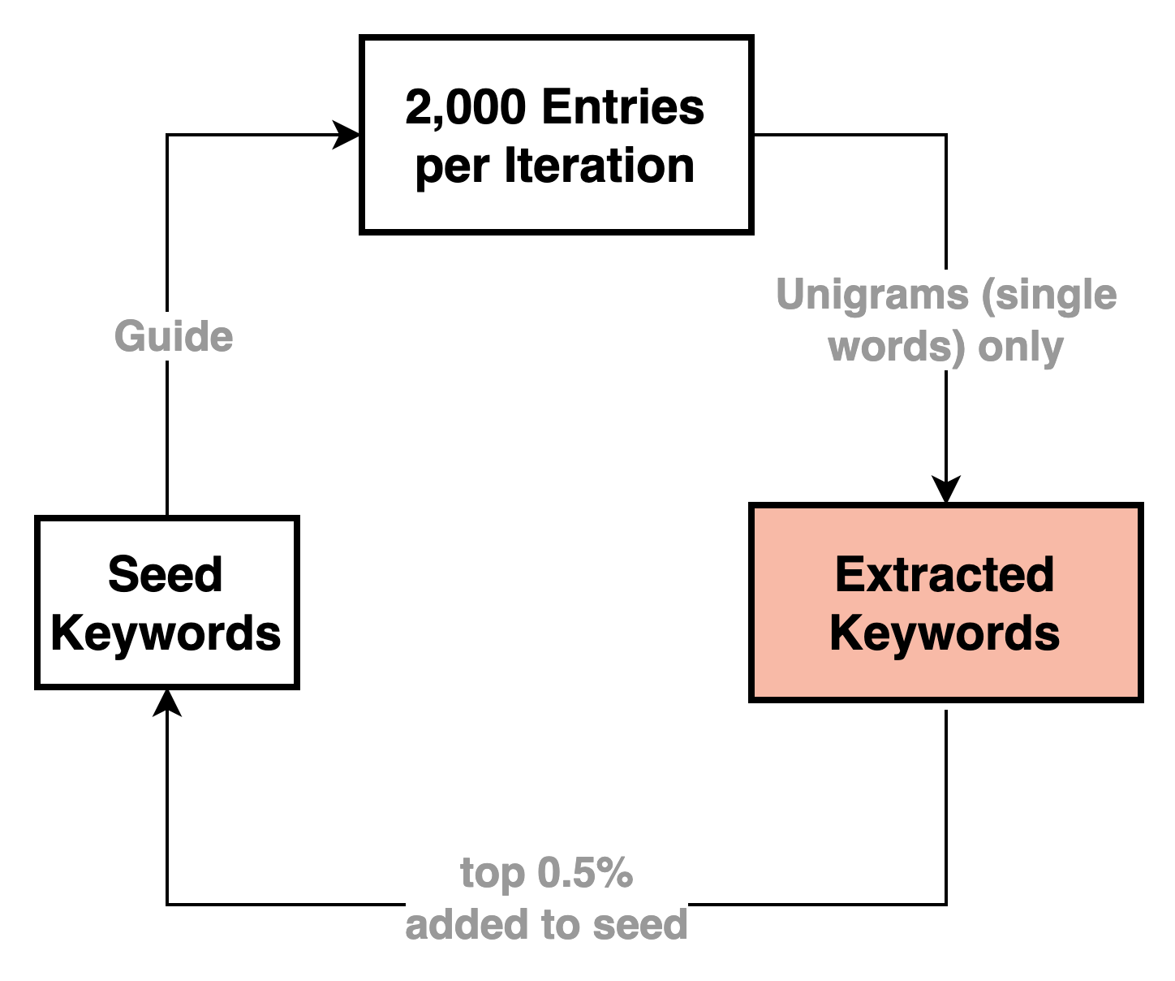
Workflow Overview - Extraction
Methodology and Filtering,
Per Class
Seed Keywords
10,000 business entries
Extracted Keywords (filtered)
Guided iterative extraction
Extracted Keywords (discarded)
Filtering with damping function
Keep top 90-100 extracted keywords
→ 5 iterations per class

Slide 9
Workflow Overview - Generation
Methodology and Filtering,
Per Class
Multiple filtering stages:
Deduplication
Removal of existing keywords
Only keep the top 25th percentile
Context combinations for lexical substitution
Class description and all seed keywords:
  [class_description]. Die Schlüsselwörter beinhalten: [seed_keywords], [target_word].
Class description and no seed keywords:
  [class_description]. Ein Schlüsselwört ist: [target_word].
No class description, all seed keywords:
  [class_name]. Die Schlüsselwörter beinhalten: [seed_keywords], [target_word].
Lexical Substitutes (discarded)
Seed Keywords
Seed Keywords
Lexical substitution in context
10,000 business entries
Lexical Substitutes (filtered)
Extracted Keywords (filtered)
Context: combinations of class description & seed keywords
Guided iterative extraction
Extracted Keywords (discarded)
Filtering with damping function
Keep top 90-100 extracted keywords

Slide 10
Workflow Overview - Generation
Methodology and Filtering,
Per Class
Multiple filtering stages:
Deduplication
Removal of existing keywords
Only keep the top 25th percentile
Lexical Substitutes (discarded)
Seed Keywords
Seed Keywords
Lexical substitution in context
10,000 business entries
Lexical Substitutes (filtered)
Extracted Keywords (filtered)
Synonym Generation using OdeNet
Context: combinations of class description & seed keywords
Guided iterative extraction
Extracted Keywords (filtered)
Synonyms
Extracted Keywords (discarded)
Filtering only with polysemy:
Keep the synonym set most similar to the seed keywords
Seed Keywords
Filtering with damping function
Keep top 90-100 extracted keywords

Slide 11
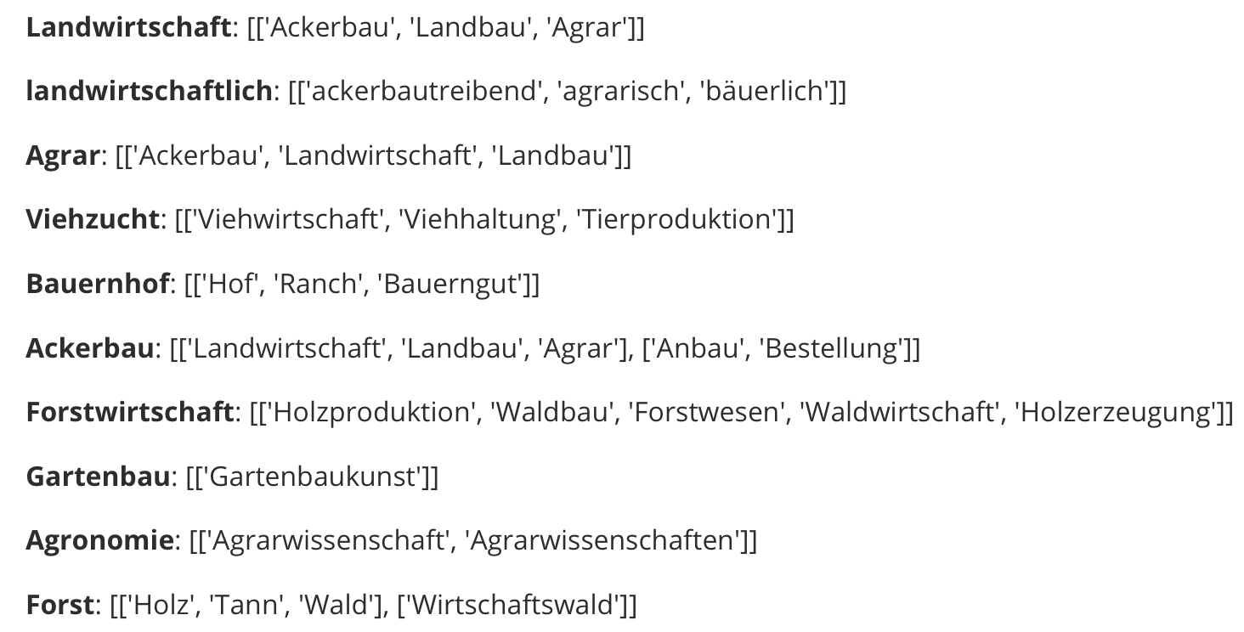
Workflow Overview - Generation
Methodology and Filtering,
Per Class
Multiple filtering stages:
Deduplication
Removal of existing keywords
Only keep the top 25th percentile
Open German Wordnet (OdeNet) [1]
Lexical Substitutes (discarded)
Seed Keywords
Seed Keywords
Lexical substitution in context
10,000 business entries
Lexical Substitutes (filtered)
Extracted Keywords (filtered)
Synonym Generation using OdeNet
Context: combinations of class description & seed keywords
Guided iterative extraction with an averaged scoring approach
Extracted Keywords (filtered)
Synonyms
Extracted Keywords (discarded)
Filtering only with polysemy:
Keep the synonym set most similar to the seed keywords
Seed Keywords
Filtering with damping function
Keep top 90-100 extracted keywords
Partial results of computing synonyms for extracted keywords
[1] Siegel, M., & Bond, F. (2021). OdeNet: Compiling a German Wordnet from other Resources. GitHub repository: https://github.com/hdaSprachtechnologie/odenet

Slide 12
Workflow Overview - Generation
Methodology and Filtering,
Per Class
Multiple filtering stages:
Deduplication
Removal of existing keywords
Only keep the top 25th percentile
Lexical Substitutes (discarded)
Seed Keywords
Word Form Generation
Seed Keywords
Seed Keywords
Lexical substitution in context
10,000 business entries
Lexical Substitutes (filtered)
Extracted Keywords (filtered)
Inflection of nouns and adjectives
Extracted Keywords (filtered)
Synonym Generation using OdeNet
Context: combinations of class description & seed keywords
Word Forms
Guided iterative extraction
Extracted Keywords (filtered)
Synonyms
Minimal filtering:
deduplication & removal of existing keywords
Extracted Keywords (discarded)
Filtering only with polysemy:
Keep the synonym set most similar to the seed keywords
Lexical Substitutes (filtered)
Seed Keywords
Filtering with damping function
Keep top 90-100 extracted keywords
[1] gambolputty. german-nouns. GitHub. https://github.com/gambolputty/german-nouns

Slide 13
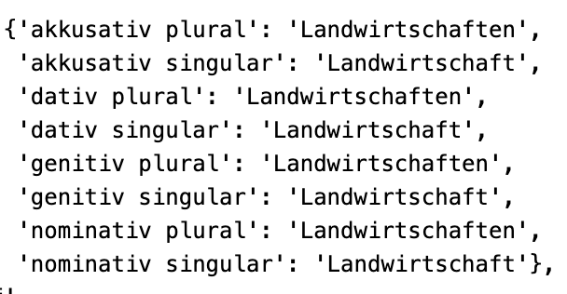
Workflow Overview - Generation
Methodology and Filtering,
Per Class
Multiple filtering stages:
Deduplication
Removal of existing keywords
Only keep the top 25th percentile
german-nouns [1]
Lexical Substitutes (discarded)
Seed Keywords
Word Form Generation
Seed Keywords
Seed Keywords
Lexical substitution in context
10,000 business entries
Lexical Substitutes (filtered)
Extracted Keywords (filtered)
Inflection of nouns and adjectives
Extracted Keywords (filtered)
Synonym Generation using OdeNet
Context: combinations of class description & seed keywords
Word forms of “Landwirtschaft”
Word Forms
Guided iterative extraction
Extracted Keywords (filtered)
Synonyms
Minimal filtering:
deduplication & removal of existing keywords
Extracted Keywords (discarded)
Adjective inflection
Filtering only with polysemy:
Keep the synonym set most similar to the seed keywords
Lexical Substitutes (filtered)
Lemmatization: “landwirtschaftlich”
Add fixed endings:
  “landwirtschaftlicher”, “landwirtschaftliche” etc.
Seed Keywords
Filtering with damping function
Keep top 90-100 extracted keywords
[1] gambolputty. german-nouns. GitHub. https://github.com/gambolputty/german-nouns

Slide 14
Workflow Overview
Methodology and Filtering,
Per Class
Multiple filtering stages:
Deduplication
Removal of existing keywords
Only keep the top 25th percentile
Comprehensive keyword set
Lexical Substitutes (discarded)
Seed Keywords
Seed Keywords
Word Form Generation
Seed Keywords
Seed Keywords
Lexical substitution in context
Extracted Keywords (filtered)
10,000 business entries
Lexical Substitutes (filtered)
Extracted Keywords (filtered)
Inflection of nouns and adjectives
Extracted Keywords (filtered)
Synonym Generation using OdeNet
Context: combinations of class description & seed keywords
Word Forms
Guided iterative extraction
Extracted Keywords (filtered)
Synonyms
Minimal filtering:
deduplication & removal of existing keywords
Extracted Keywords (discarded)
Filtering only with polysemy:
Keep the synonym set most similar to the seed keywords
Synonyms
Lexical Substitutes (filtered)
Seed Keywords
Lexical Substitutes (filtered)
Filtering with damping function
Keep top 90-100 extracted keywords
EXTRACTION
GENERATION

Slide 15
Evaluation Methodology
Intruder Detection
Automatic Evaluation
Expert Validation

Slide 16
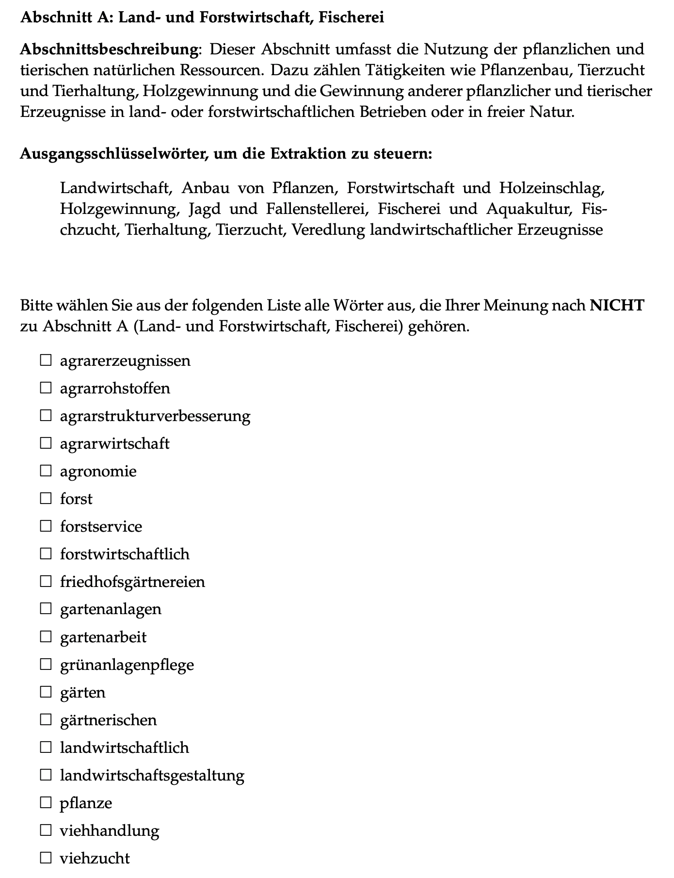
Evaluation Methodology
Expert Validation
Domain experts validate relevance and accuracy of extracted keywords
By identifying keywords that do not belong to each sampled class
Five classes in total
A representative subset (avg. 18 per class): every fifth keyword from the filtered extracted set, ranked by descending similarity scores
Class descriptions and seed keywords presented as “context”
Example: expert validation question with instructions, class A

Slide 17
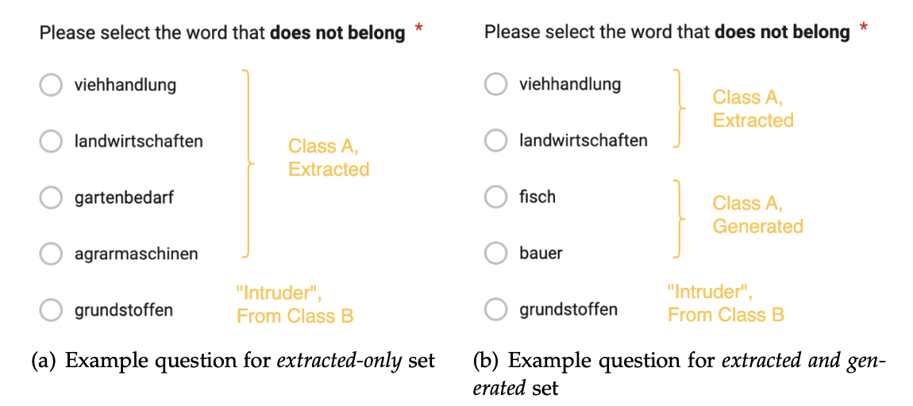
Evaluation Methodology
Intruder Detection
Expert Validation
Domain experts validate relevance and accuracy of extracted keywords
By identifying keywords that do not belong to each sampled class
Five classes in total
A representative subset (avg. 18 per class): every fifth keyword from the filtered extracted set, ranked by descending similarity scores
Class descriptions and seed keywords presented as “context”
Coherence evaluation of the keyword sets
Participants select the keyword (out of 5 options) that “does not belong”
25 questions for 5 classes
Two different keyword sets: extracted-only and extracted+generated keywords.
Randomized question sequence and option orders

Slide 18
Evaluation Methodology
Intruder Detection
Automatic Evaluation
Expert Validation
Calculate similarity of each class’s keyword set to its seed keywords
On these keyword sets (filtered)
Extracted keywords
New keywords from lexical substitution
New keywords from synonym generation
New keywords from word form generation
All new generated keywords (stages 2-4)
Entire keyword set (stages 1-4)
Domain experts validate relevance and accuracy of extracted keywords
By identifying keywords that do not belong to each sampled class
Five classes in total
A representative subset (avg. 18 per class): every fifth keyword from the filtered extracted set, ranked by descending similarity scores
Class descriptions and seed keywords presented as “context”
Coherence evaluation of the keyword sets
Participants select the keyword (out of 5 options) that “does not belong”
25 questions for 5 classes
Two different keyword sets: extracted-only and extracted+generated keywords.
Randomized question sequence and option orders

Slide 19
Outline
Introduction
  Motivation and Goals (Recap)
  Research Questions
Research Approach
  Dataset
  Methodology
Findings
  Extraction Results
  Generation Results
Discussions
  Contributions
  Challenges and Future Work
Conclusion

Slide 20
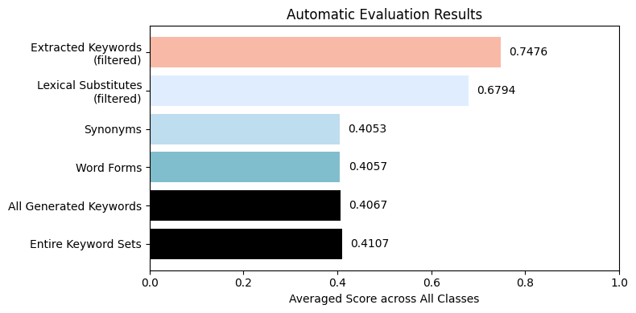
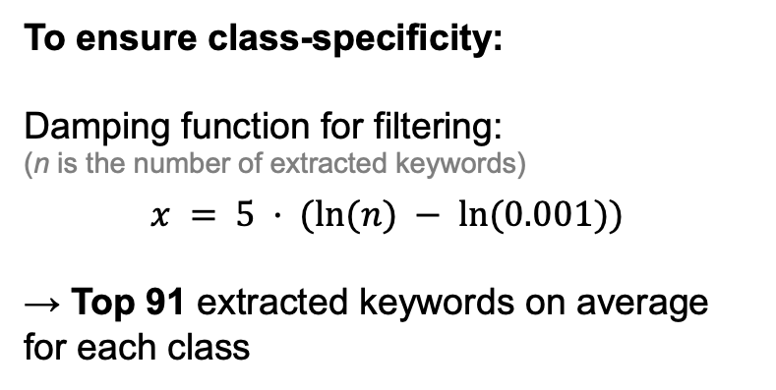
Extraction Results
  165,206 keywords across the 21 classes
    7,867 keywords per class
      Ranging from 6,581 to 8,920
  Time: ~15 minutes per class (GPU)
To ensure class-specificity:
Damping function for filtering:
(n is the number of extracted keywords)
$$x = 5 · (ln⁡(n) − ln⁡(0.001))$$
→ Top 91 extracted keywords on average for each class
Automatic evaluation: similarity to seed keywords

Slide 21
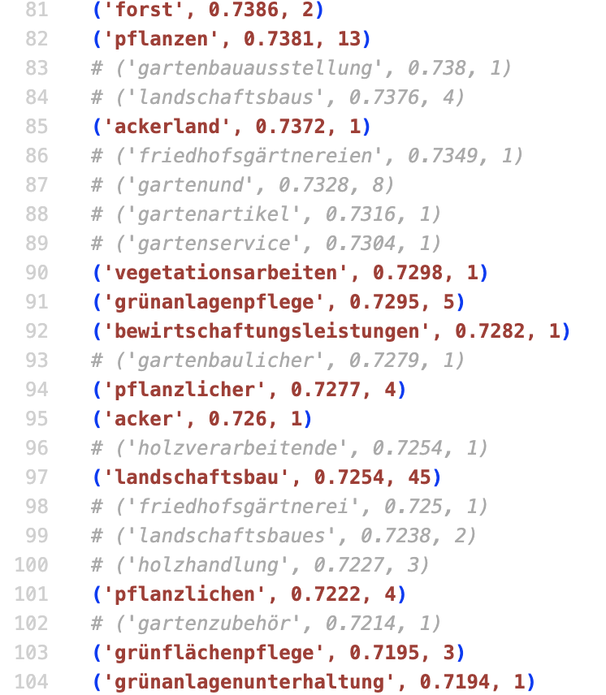
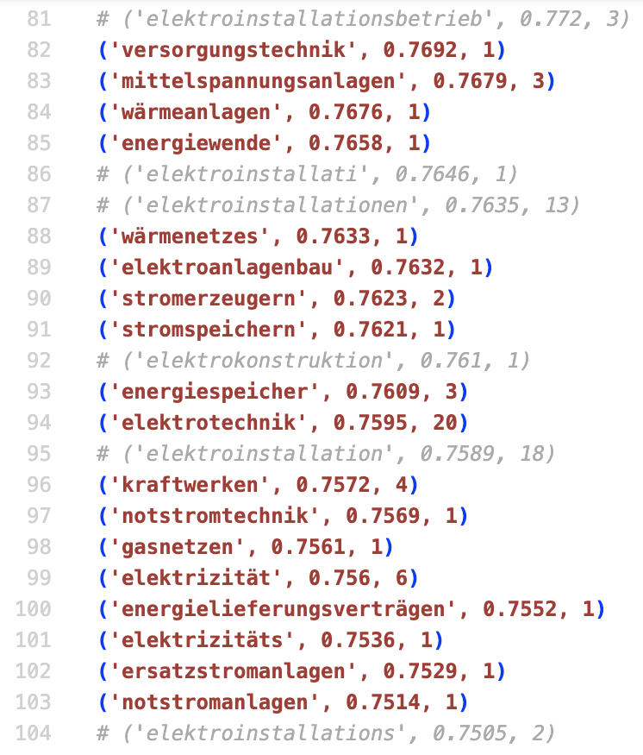
Extraction Challenges: Precision vs. Exhaustiveness
Rationale for High Filtering Threshold
Prioritize Precision
At the cost of sidelining potential keywords
Minimize the effect of erroneous terms and their propagation
Class A (agriculture, forestry and fishing):
extracted keywords
Class D (energy supply):
extracted keywords
Class variations in “good” filtering point
Gray: non-class-specific keywords

Slide 22
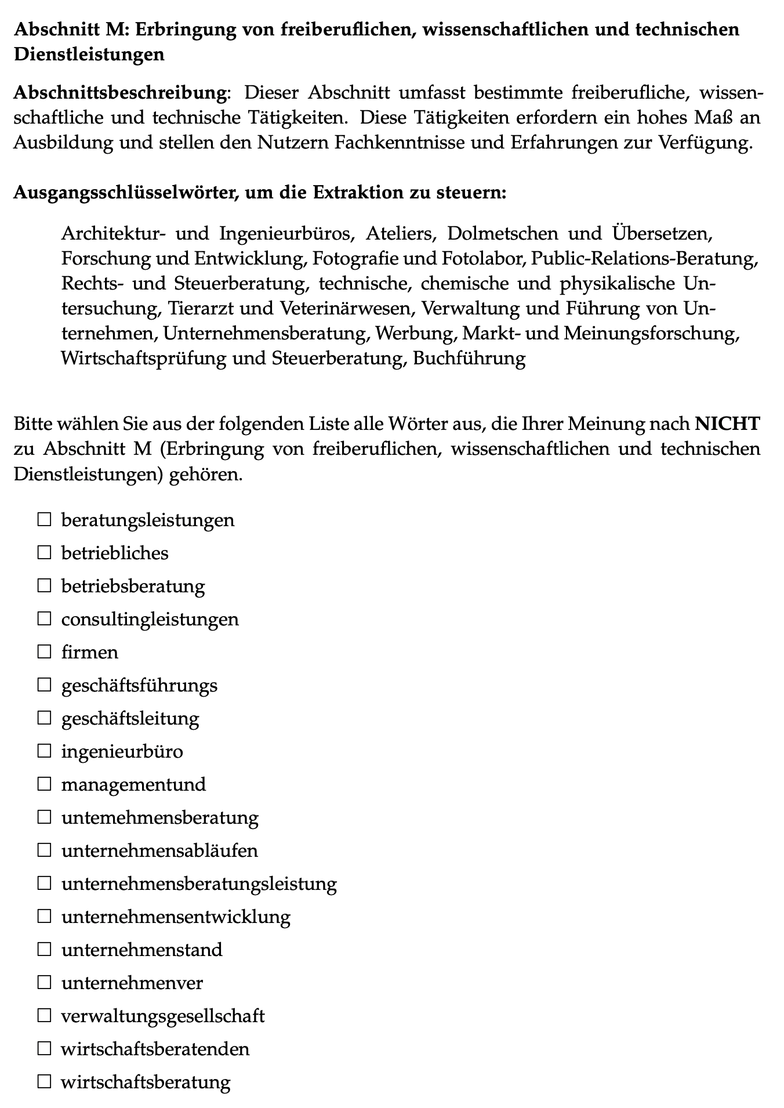
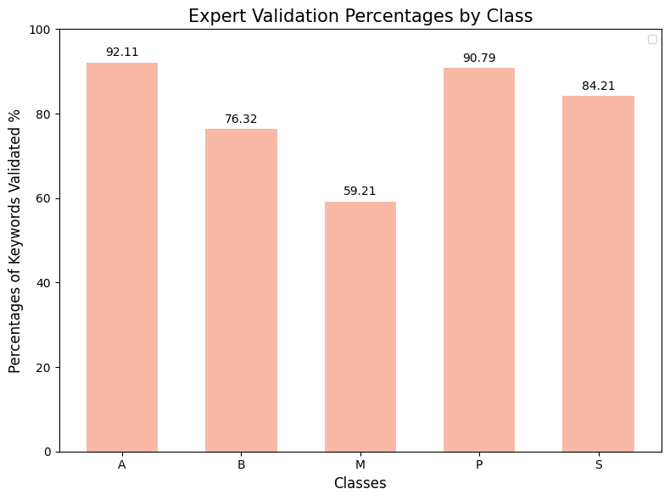
Extraction Results: Expert Validation
Problematic terms
Typographical errors
Overly generic terms
4 Expert participants
On average: 80.53% of the sampled extracted keywords were validated in each class
Issues/Outlook
Need enhanced filtering mechanism
Eliminate generic terms
Only a small portion presented to domain experts
Expert feedback: Difficult to differentiate between keywords
✅ Coherence and class-specificity
❌ Broader spectrum needed
Class M: Presented Keywords

Slide 23
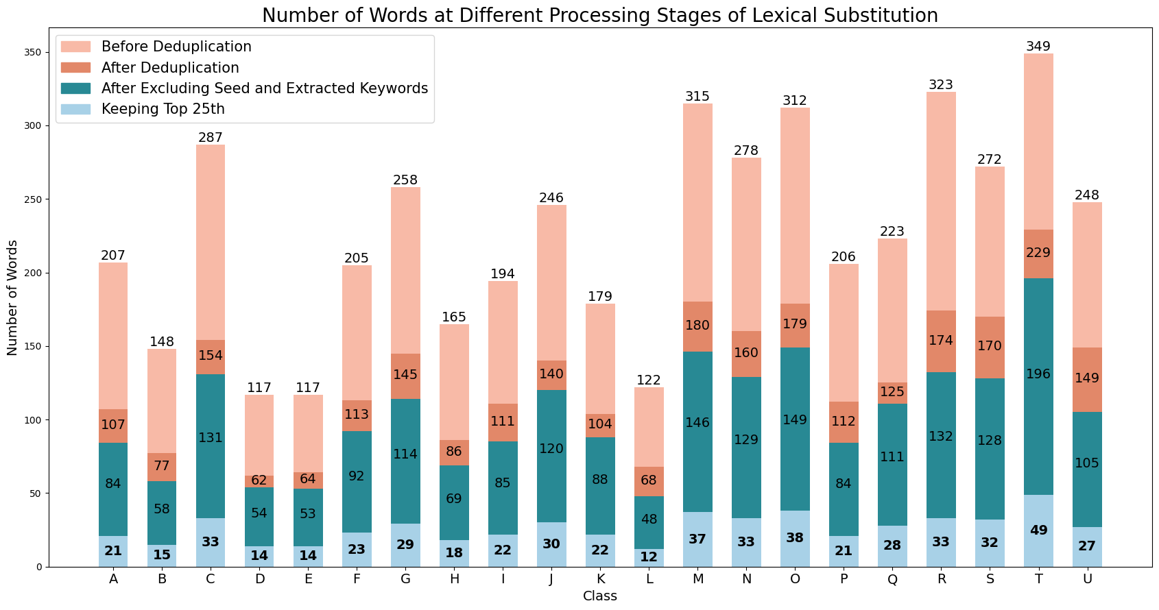
Generation Results – Lexical Substitution
Automatic evaluation: similarity to seed keywords
Average lexical substitute count per class:
    Without any post-processing: 228
    Removing duplicates and existing terms: 104
    After keeping the top 25th percentile: 27
Time: 40 minutes total, ~1.9 minutes per class (GPU)
Precision over exhaustiveness

Slide 24
Generation Results – Synonym and Word Form Generation
Automatic evaluation: similarity to seed keywords
(Averaged per Class) | Synonym Generation | Word Form Generation
Count without post-processing | 107 | 392
Count after removing duplicates & existing keywords | 98 | 200
Time (GPU) | 3.6 minutes | 1 second
→ Word form generation more heavily influenced by synonyms
Limitations
  Better (potentially more stringent) filtering mechanism needed for synonym generation → not just limited to polysemy
  Potential error propagation
Example: Pitfall of polysemy-only filtering approach
Target word: Mineral (in mining context)
Synonyms with meaning of “mineral water” rather than “mineral” with a geological interpretation:
  {Soda, Mineralwasser, stilles Wasser, Tafelwasser, Sprudel, Wasser, …}

Slide 25
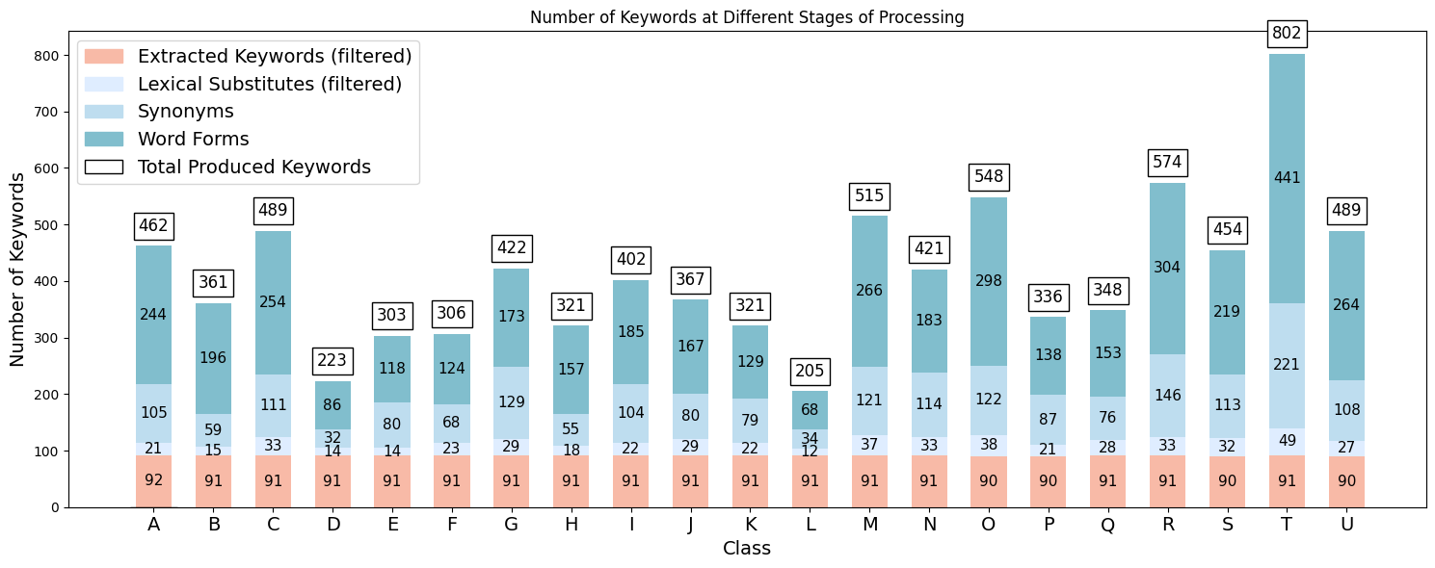
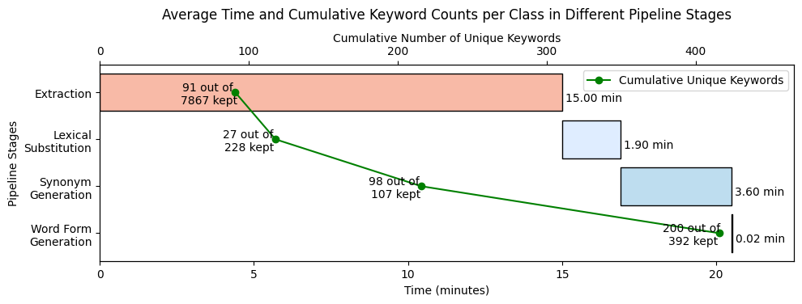
Statistical Overview of Pipeline Results
Number of Keywords at Different Pipeline Stages
A lot more generated keywords than extracted
  Extracted: 91
  Generated: 322
→ Overall results more heavily influenced by generated terms
  Could be problematic with “disruptive” keywords
~20.5 minutes for the entire pipeline per class
Many “unused” keywords, especially during extraction and lexical substitution
  → precision over exhaustiveness

Slide 26
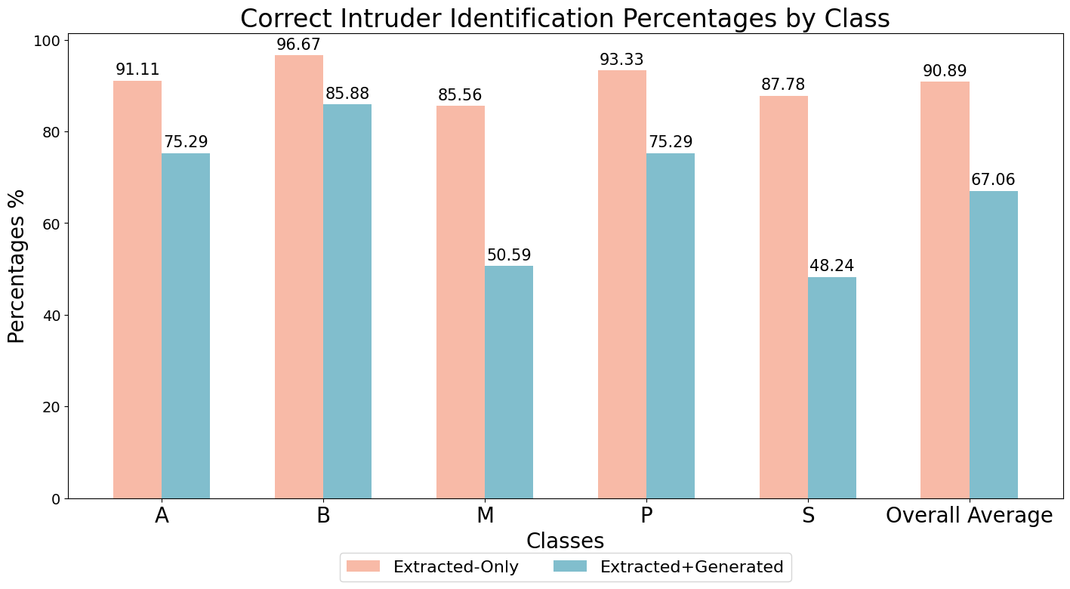
Generation Reevaluated
Automatic evaluation: similarity to seed keywords
Problem:
“Disruptive” keywords from generation steps (especially synonym generation)
  → less coherent keyword sets
Solution Ideas:
For synonym generation:
  Omit this step or
  Use more stringent filtering mechanisms
→ Some extent of generation is still needed for comprehensiveness of the keyword sets

Slide 27
Outline
Introduction
  Motivation and Goals (Recap)
  Research Questions
Research Approach
  Dataset
  Methodology
Findings
  Extraction Results
  Generation Results
Discussions
  Contributions
  Challenges and Future Work
Conclusion

Slide 28
Contributions of the Proposed Approach
A systematic pipeline for keyword extraction and generation with domain knowledge incorporation
Extraction efficiency: at least 64 times faster than manual extraction
Assumptions
Prerequisite: acquiring domain knowledge
Familiarize with class context: 5 min * 21 classes = 105 min
Identify seed keywords: 5 min * 21 classes = 105 min
Required in both approaches and should take similar amount of time
Manual extraction (minimum requirements)
Total number of words in dataset: 290,266 words
Average reading speed: 300 words/min
Average processing speed for extraction = average reading speed
Time needed: ~968 minutes (over 16 hours)
Our approach
Completes extraction in ~15 minutes
64 times
Generalizability to various domains
Configurability of parameters to suit different needs

Slide 29
Challenges and Future Work
Data Reliance and Subjectivity
More expert participation
Larger evaluation sets
Extraction challenges
  Precision vs. exhaustiveness
  Error propagation from iteration
Better filtering mechanism for extraction
  Explicit “exclude list”
  Error pruning in iteration
More stringent filtering for generation
  Intra-synset filtering, even with monosemous words
  Cross-synset filtering: consider more than one synset
Efficacy of generation approaches
Especially during synonym generation
Lack on contextualization in:
  Embedding seed keywords
  Computing similarity to seed keywords
Context integration in embedding process
  E.g. Use class descriptions as context for generating seed embeddings

Slide 30
Outline
Introduction
  Motivation and Goals (Recap)
  Research Questions
Research Approach
  Dataset
  Methodology
Findings
  Extraction Results
  Generation Results
Discussions
  Contributions
  Challenges and Future Work
Conclusion

Slide 31
Conclusion
Core contributions
  A systematic approach to domain-specific keyword extraction and generation
    Substantially improved efficiency over manual methods
  While retaining precision and relevance to the provided domain knowledge
Major challenges
  Error propagation due to sequential pipeline
  Precision vs. exhaustiveness
Future work
  Main focus: enhancement of the filtering mechanism

Slide 32
Weixin Yan
17132
matthes@in.tum.de

